Slide 1

How to install a CarpenPi

Slide 2
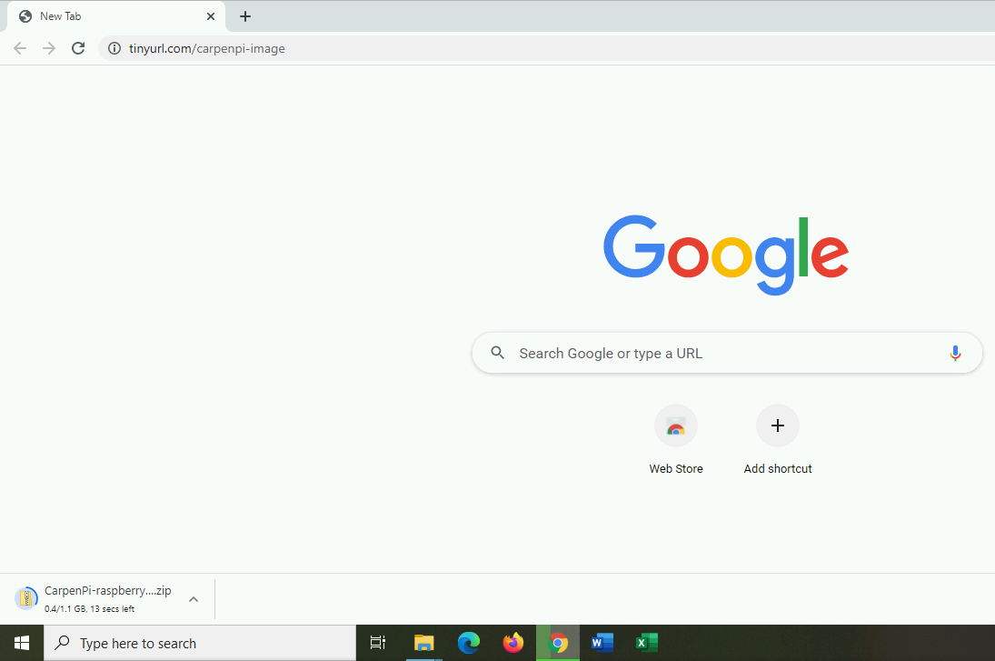
Download the image
Get it from https://tinyurl.com/carpenpi-image

Slide 3
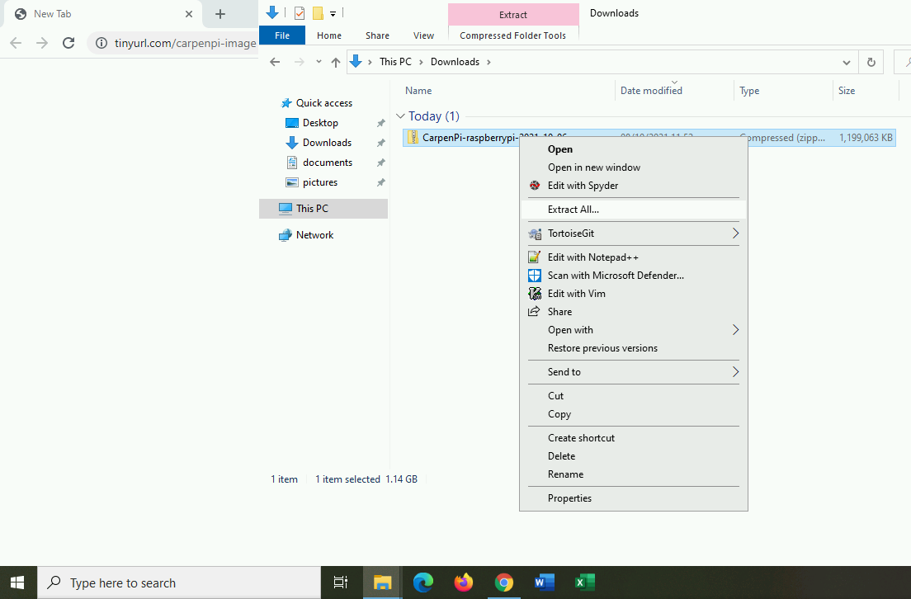
Unzip the download
Unzip the file you just downloaded (CarpenPi-raspberrypi-2021-10-06.zip)

Slide 4
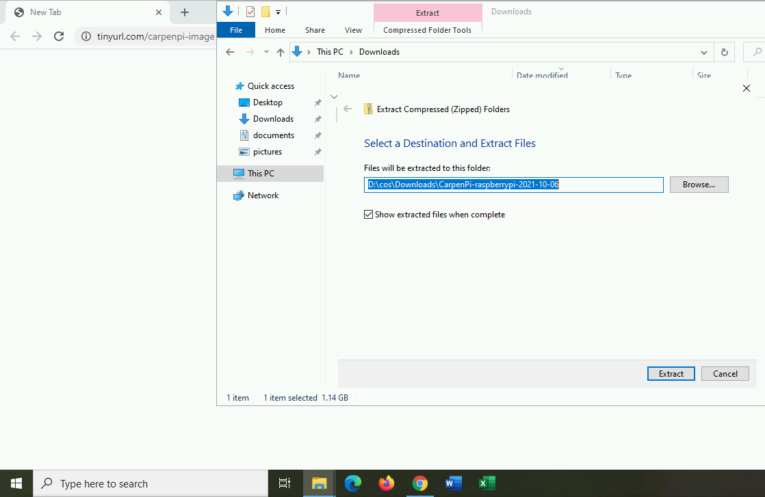
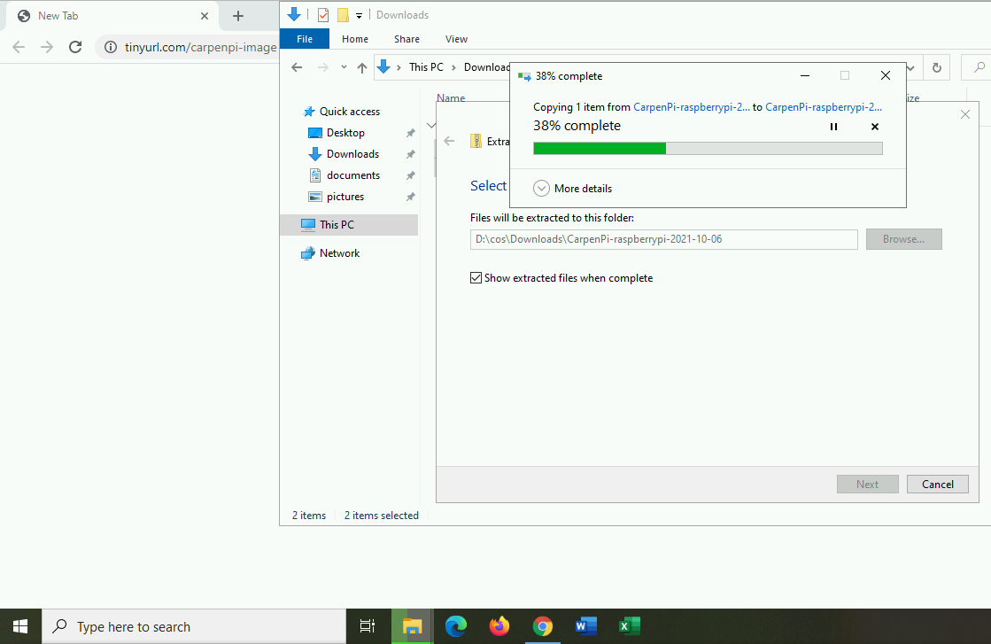
Choose where to save the files
Select “Show extracted files when complete”
Extracting the zip file may take a few minutes

Slide 5
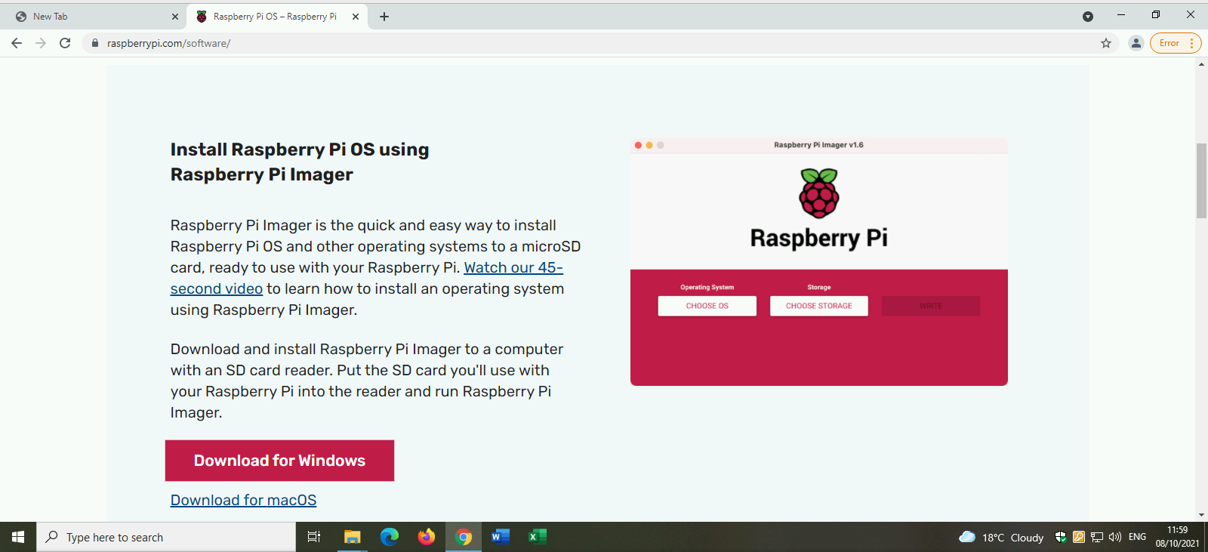
Download the Raspberry Pi Imager
From https://raspberrypi.org/software

Slide 6
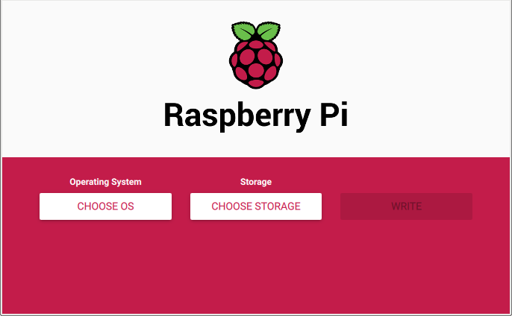
Start the Raspberry Pi Imager
Run the program you just downloaded
You will need administrator privileges on your computer.

Slide 7
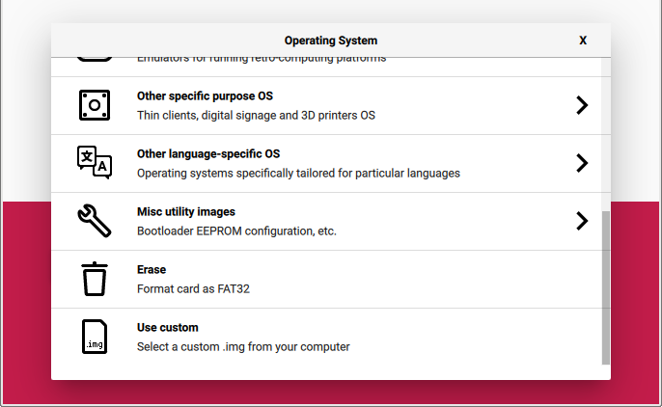
Choose the file to write to the SD card
Click “Choose OS”, then “Use custom”
Find the file you just extracted from the zip.
  It should be called carpenpi-2021-10-6.img or carpenpi-2021-10-6

Slide 8
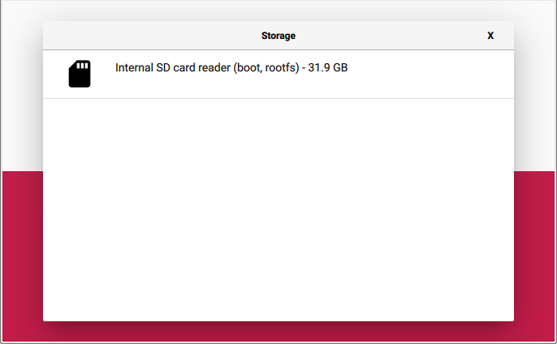
Choose the Device to Write to
Insert a blank SD card into your computer’s SD card slot
  Or use a USB SD card reader
Click “Choose Storage”
Choose your SD card device

Slide 9
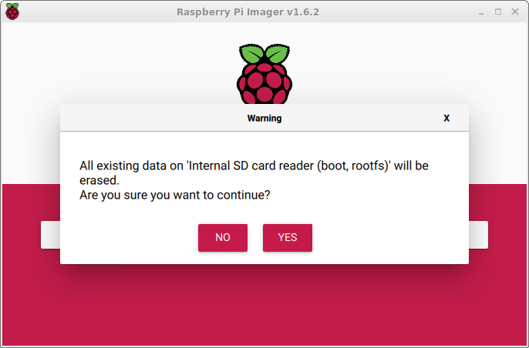
Agree to the warning
Remember: Everything on your SD card will be deleted.

Slide 10
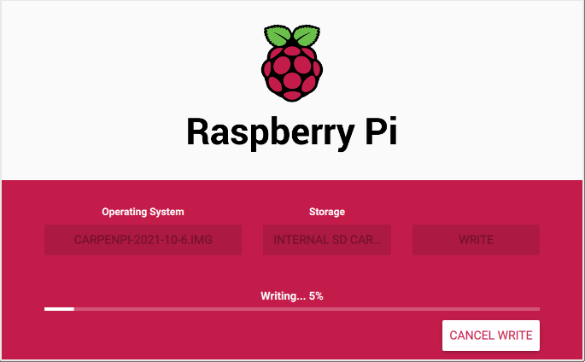
Wait for the SD Card to Write
This will take several minutes

Slide 11
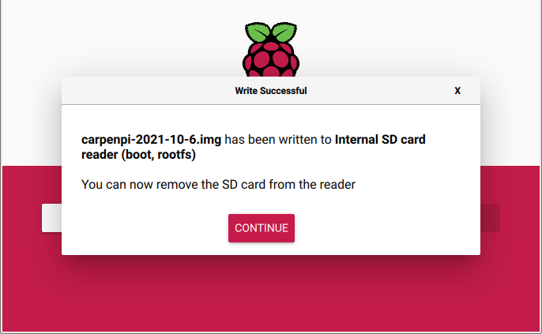
SD card finished
You can now remove the SD card

Slide 12
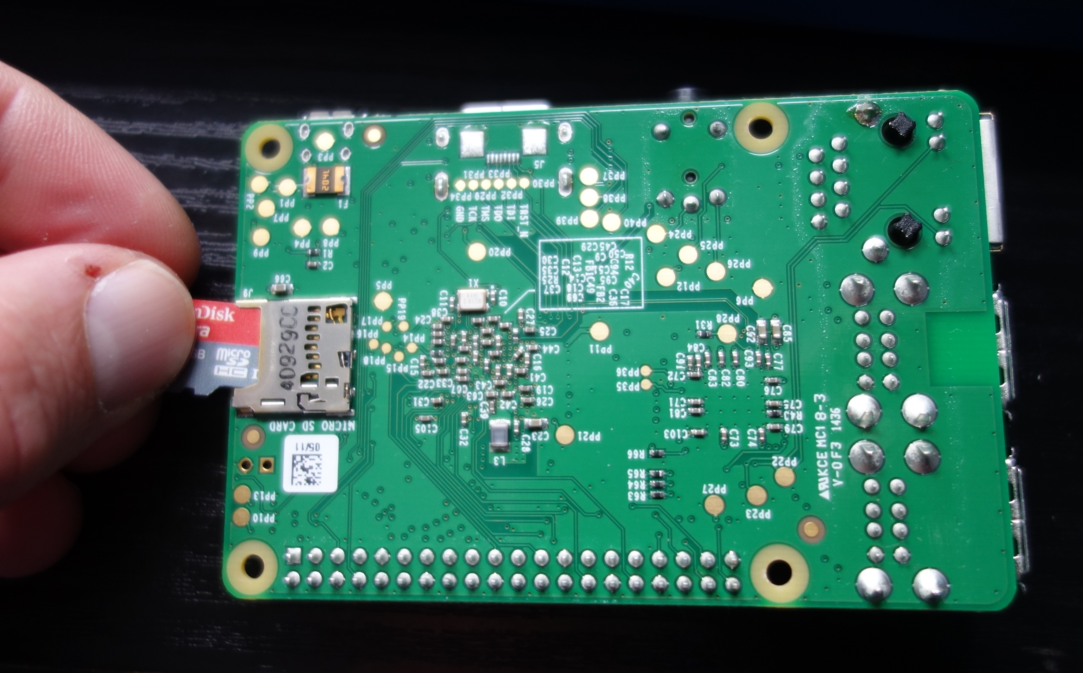
Put the SD card in the Raspberry Pi

Slide 13
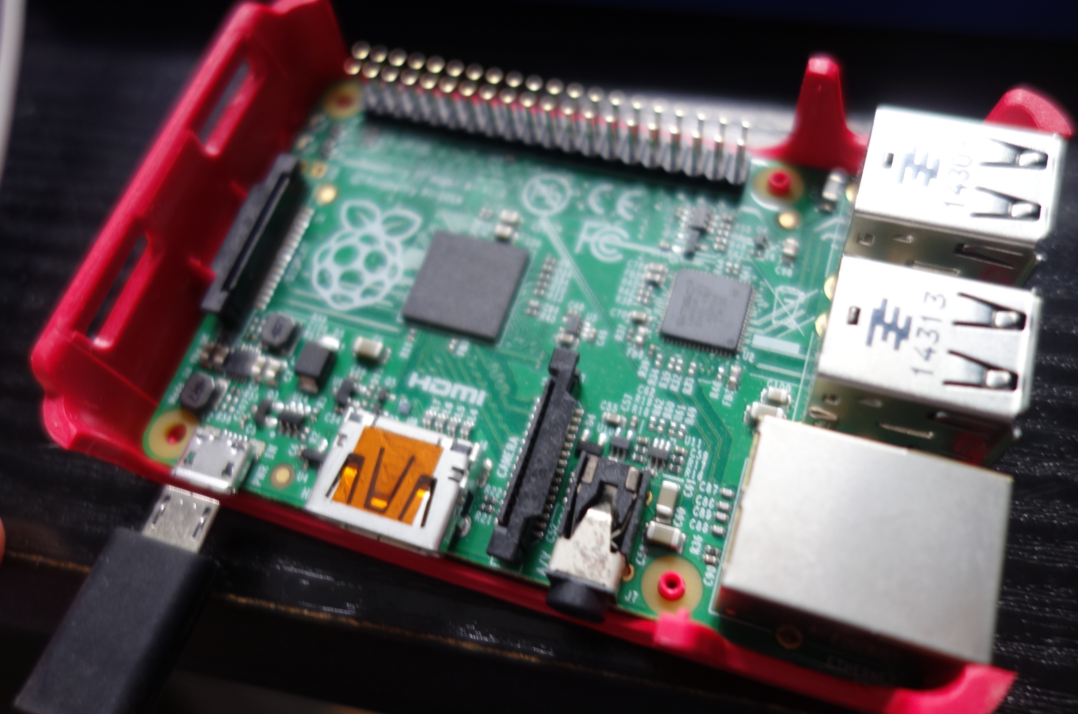
Power on the Raspberry Pi

Slide 14
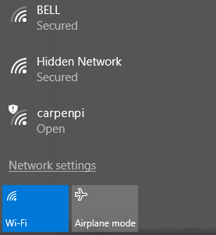
Connect to the Carpenpi network
Find the carpenpi WiFi network and connect to it

Slide 15
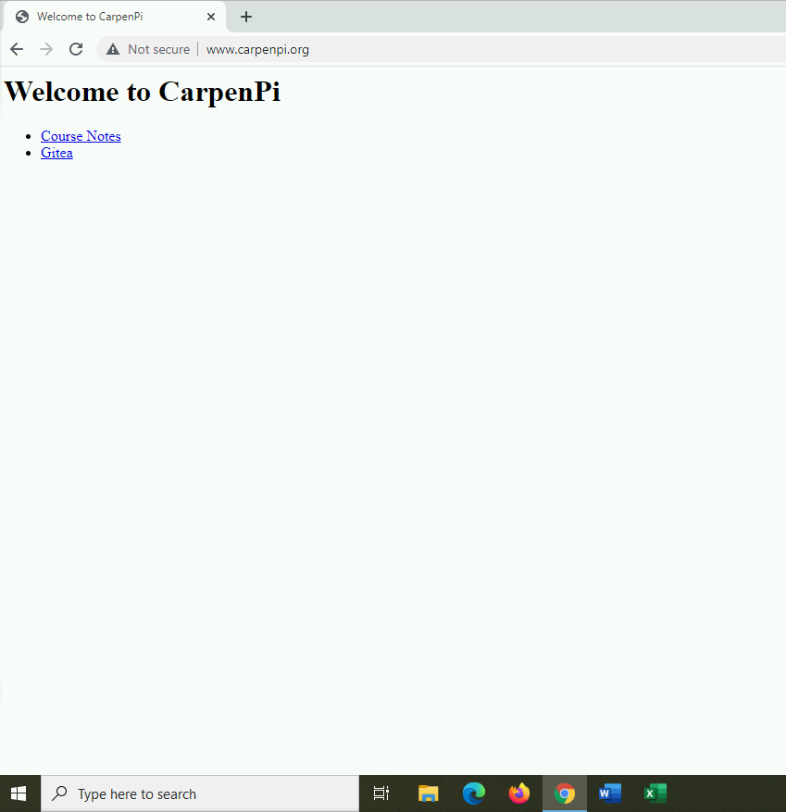
Connect to the CarpenPi website
Go to http://carpenpi.org

